Slide 1

1.Cholera Home Page

Slide 2
1.1 Header Section

Slide 3
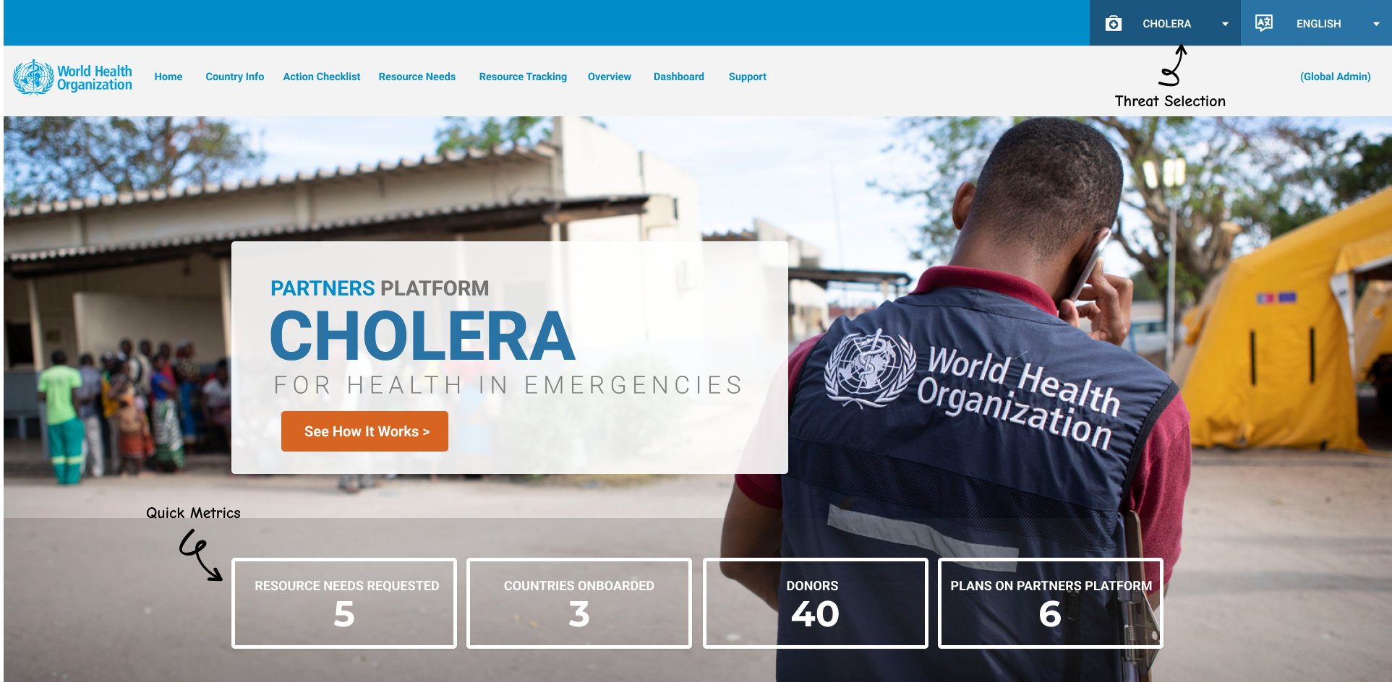

Slide 4
1.2 Strategy Section

Slide 5
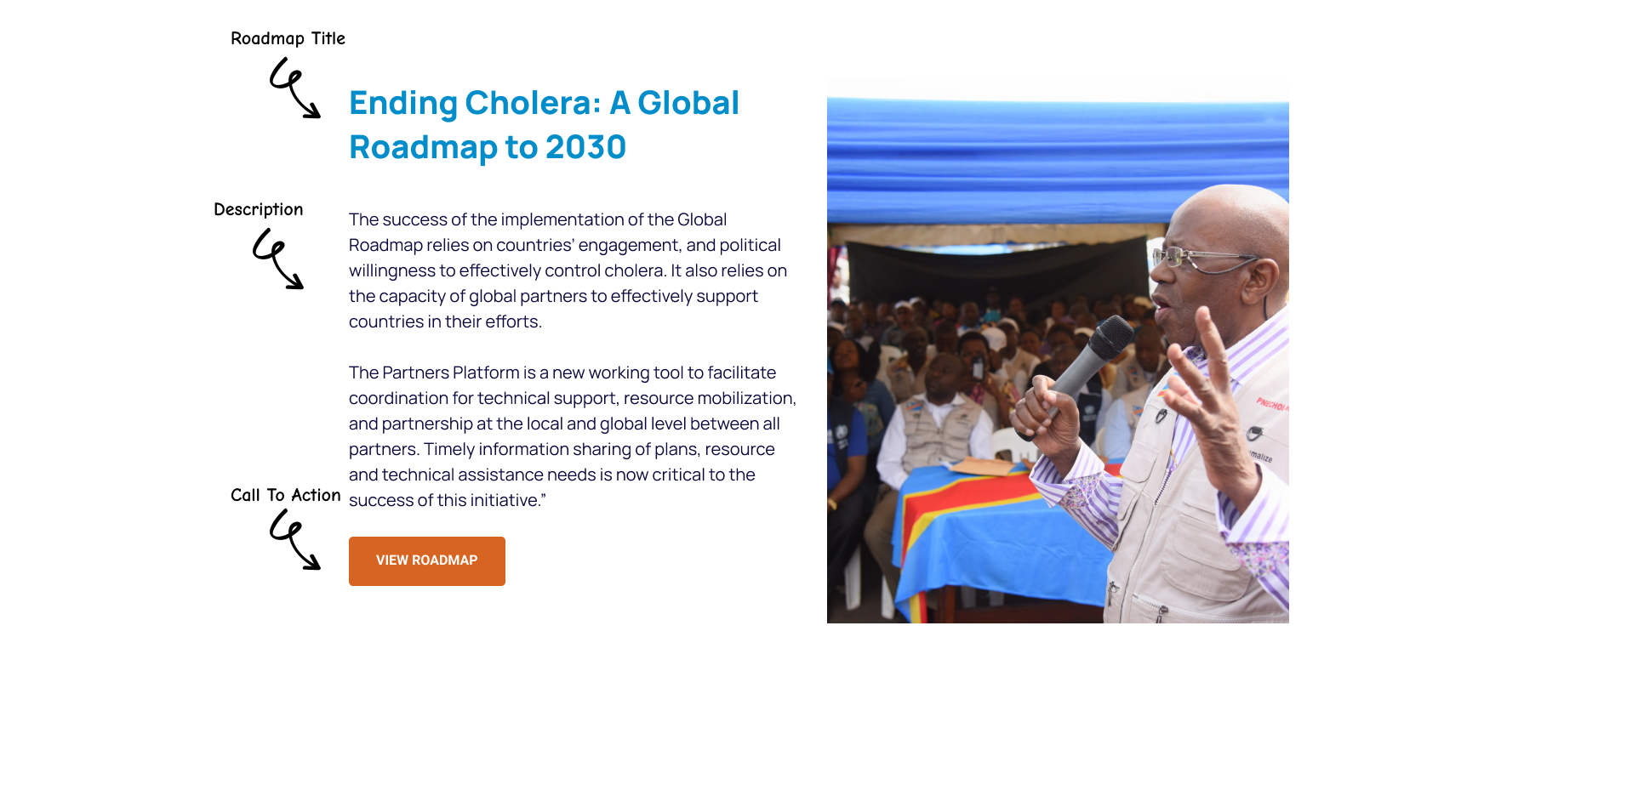

Slide 6
1.3 Cholera PP Features

Slide 7
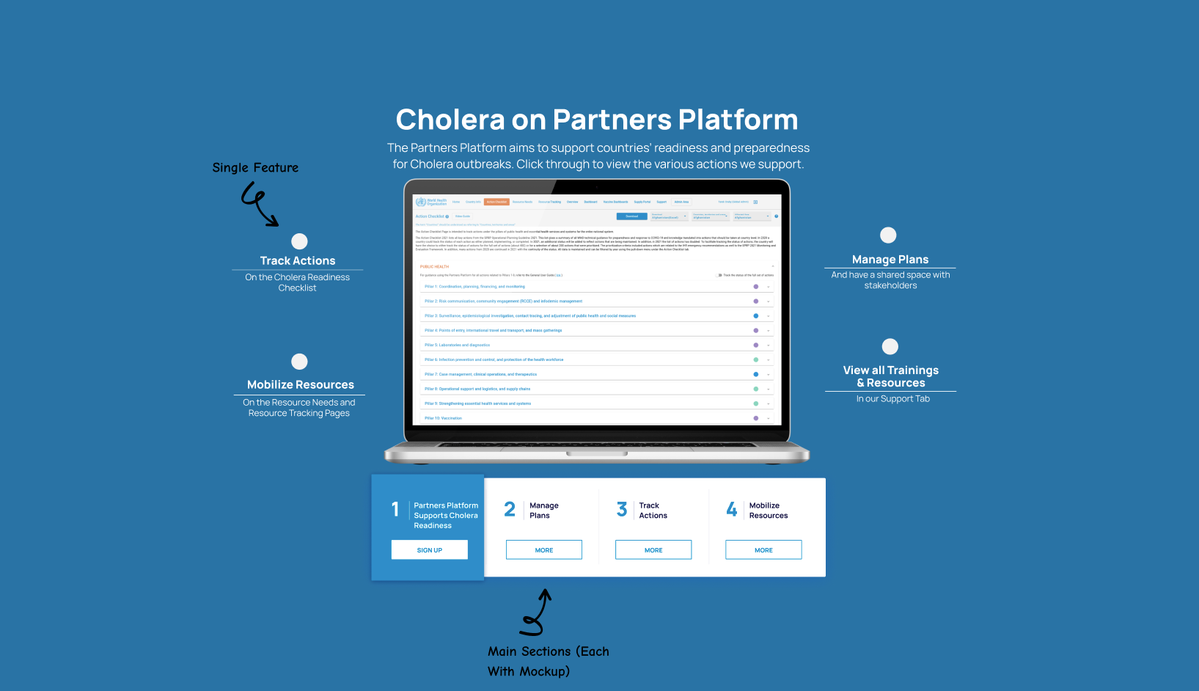

Slide 8
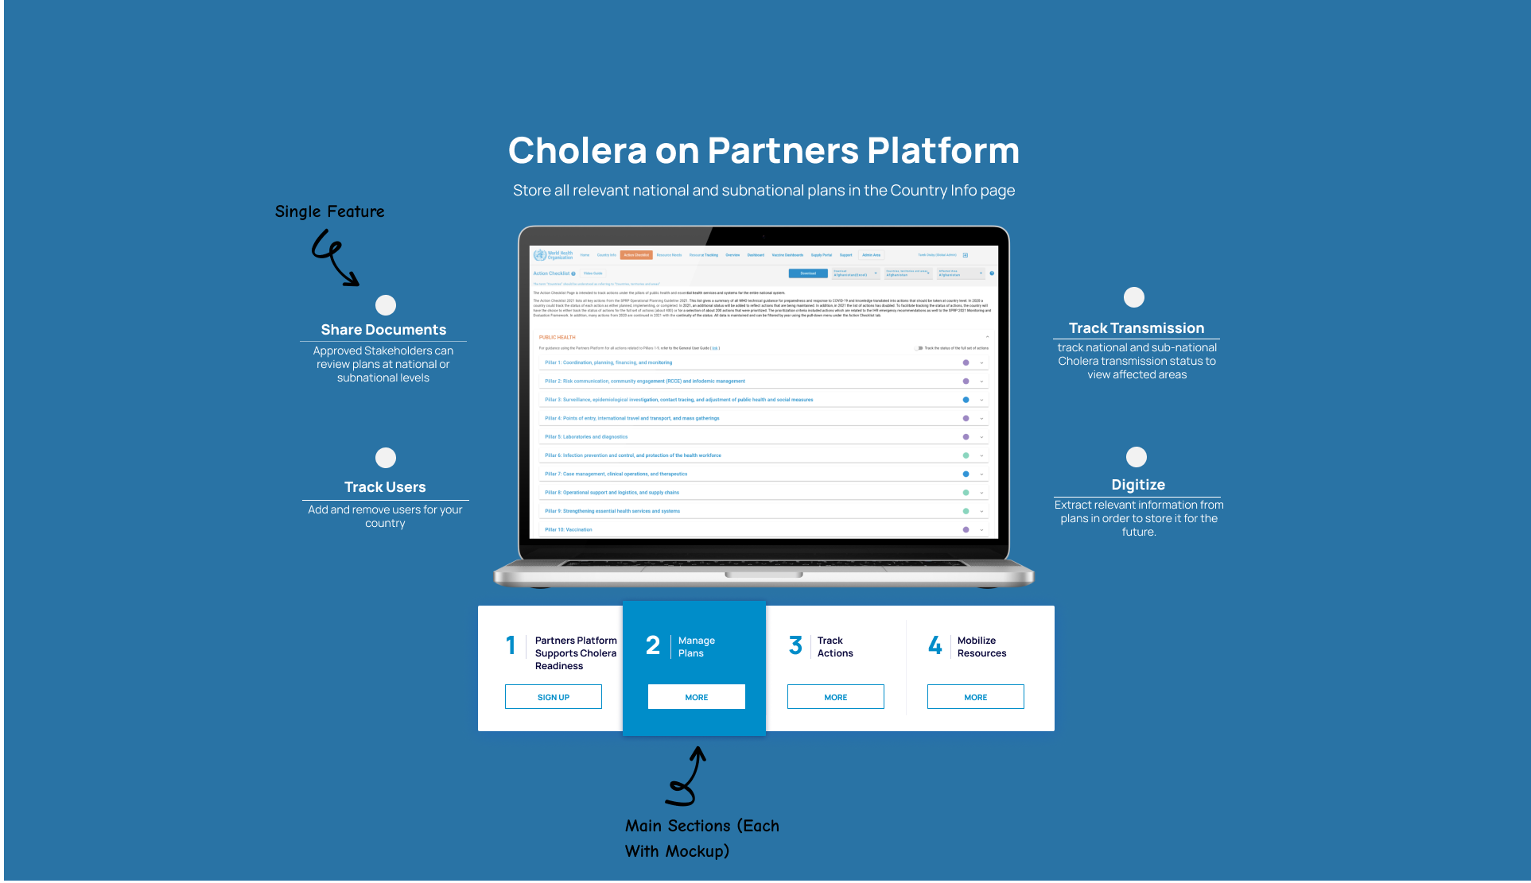

Slide 9
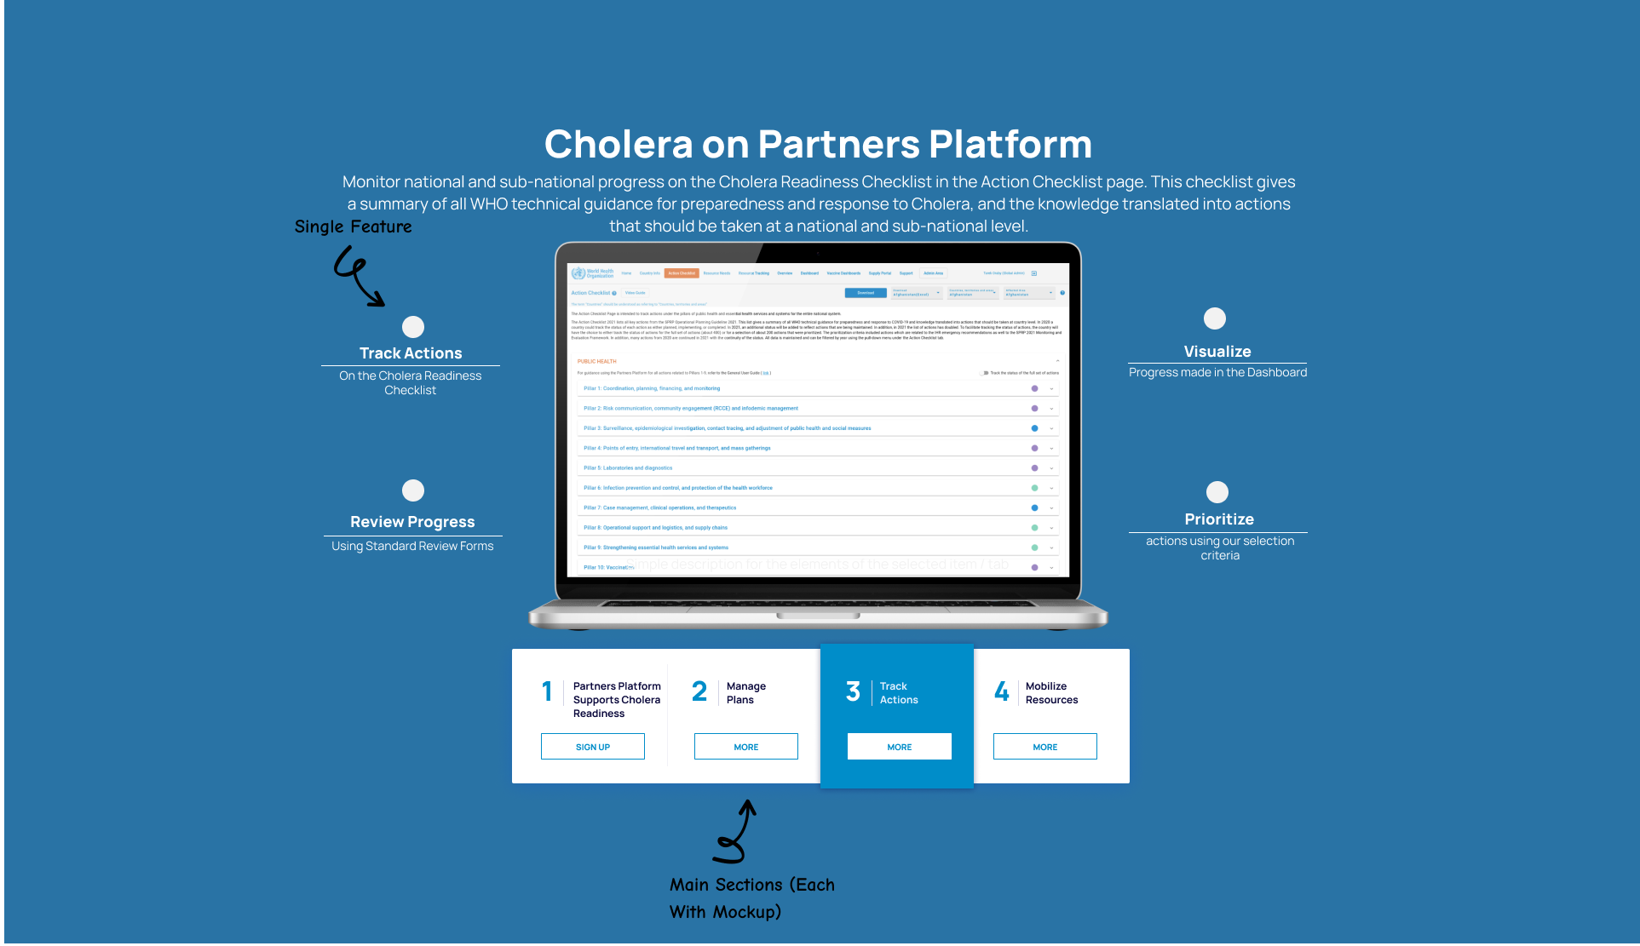

Slide 10
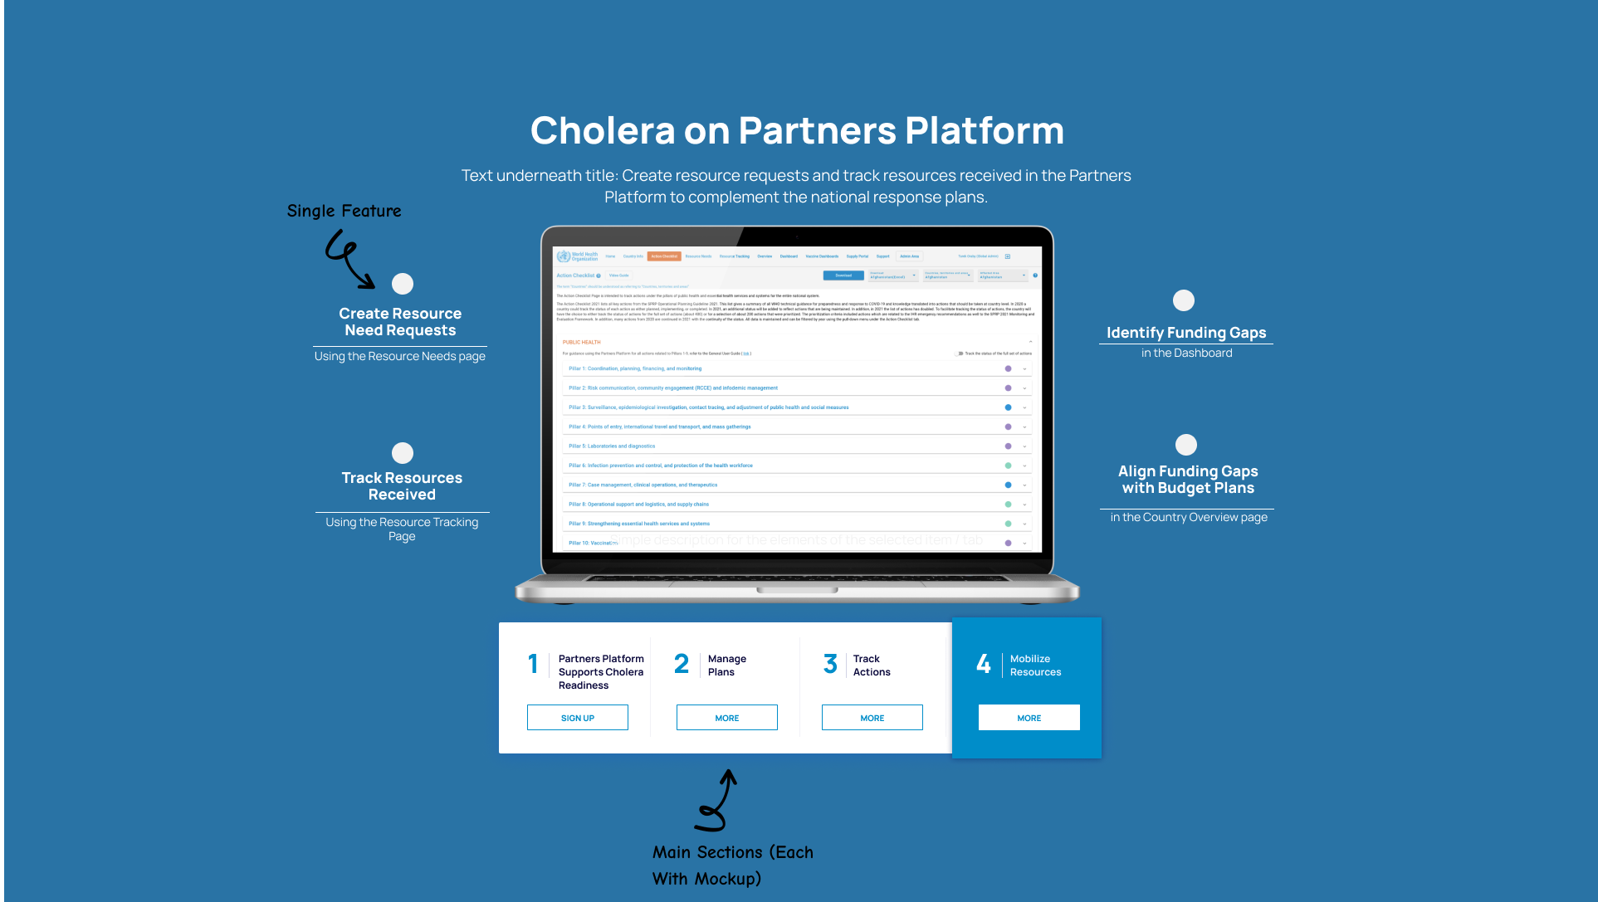

Slide 11
2. Country Info

Slide 12
Country info
Action Checklist
Resource Track.
Dashboard
Country info
National
Add sub-national areas affected by cholera ……….. etc
1. Choose a sub-national transmission classification for different countries
Transmission Classification:
Save
Affected Areas
Add
Admin Level 1 Admin Level 2 Transmission classification Capacity level Severity
Area
Area
Community Trans.
Level 2
Affected
Action Checklist Edit Delete
Area
Area
Community Trans.
Level 2
Risk
Action Checklist Edit Delete
Area
Area
Community Trans.
Level 2
High Risk
Action Checklist Edit Delete
Country, Territory or Area Plans
Add
Cholera Strategic Readiness and Response Plans (national and subnational plans)
Country, Territory or Area Users
Export to excel
Invite
2. Maintain the user database
Notes:
Plans:
Cholera Strategic Readiness and Response Plan
Cholera Elimination Plan
Cholera Operational Readiness Checklist
Cholera Reviews (SimEx Reports, Intra-Action and After Action Reviews, and Others)

Slide 13
Country info
Action Checklist
Resource Track.
Dashboard
Country info
National
Add sub-national areas affected by cholera ……….. etc
Transmission Classification:
Save
Affected Areas
Add
Admin Level 1 Admin Level 2 Transmission classification Capacity level Severity
Area
Area
Community Trans.
Level 2
Affected
Action Checklist Edit Delete
Area
Area
Community Trans.
Level 2
Risk
Action Checklist Edit Delete
Area
Area
Community Trans.
Level 2
High Risk
Action Checklist Edit Delete
Country, Territory or Area Plans
Add
Cholera Strategic Readiness and Response Plans (national and subnational plans)
Separate spaces for the following documents:
1. Cholera Strategic Readiness and Response Plan
2. Cholera Elimination Plan
3. Cholera Operational Readiness and Response Checklist
4. Cholera Reviews (SimEx, Intra-Action, and After-Action Reviews, and Other)
Any other plans you would like to store
Country, Territory or Area Users
Export to excel
Invite
Notes:
Plans:
Cholera Strategic Readiness and Response Plan
Cholera Elimination Plan
Cholera Operational Readiness Checklist
Cholera Reviews (SimEx Reports, Intra-Action and After Action Reviews, and Others)

Slide 14
3. Action Checklist

Slide 15
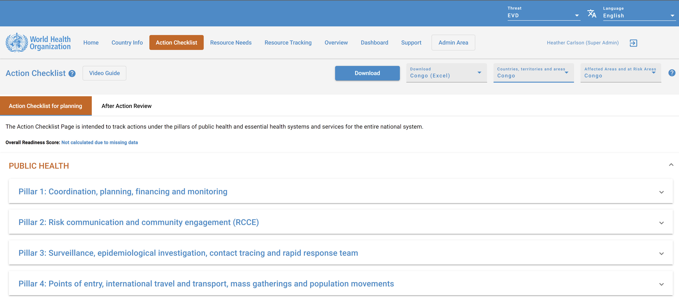

1. Choose the affected country here. Have the ability to download the filled out action checklists/reviews of each country
2. Use this section to fill out the action checklist, or an after action review
3. Have a section for each pillar of the action checklist, to be filled out here.
Possible alternative: have a section where countries can upload their action checklists in an excel format. This data can be populated automatically on to the Platform

Slide 16
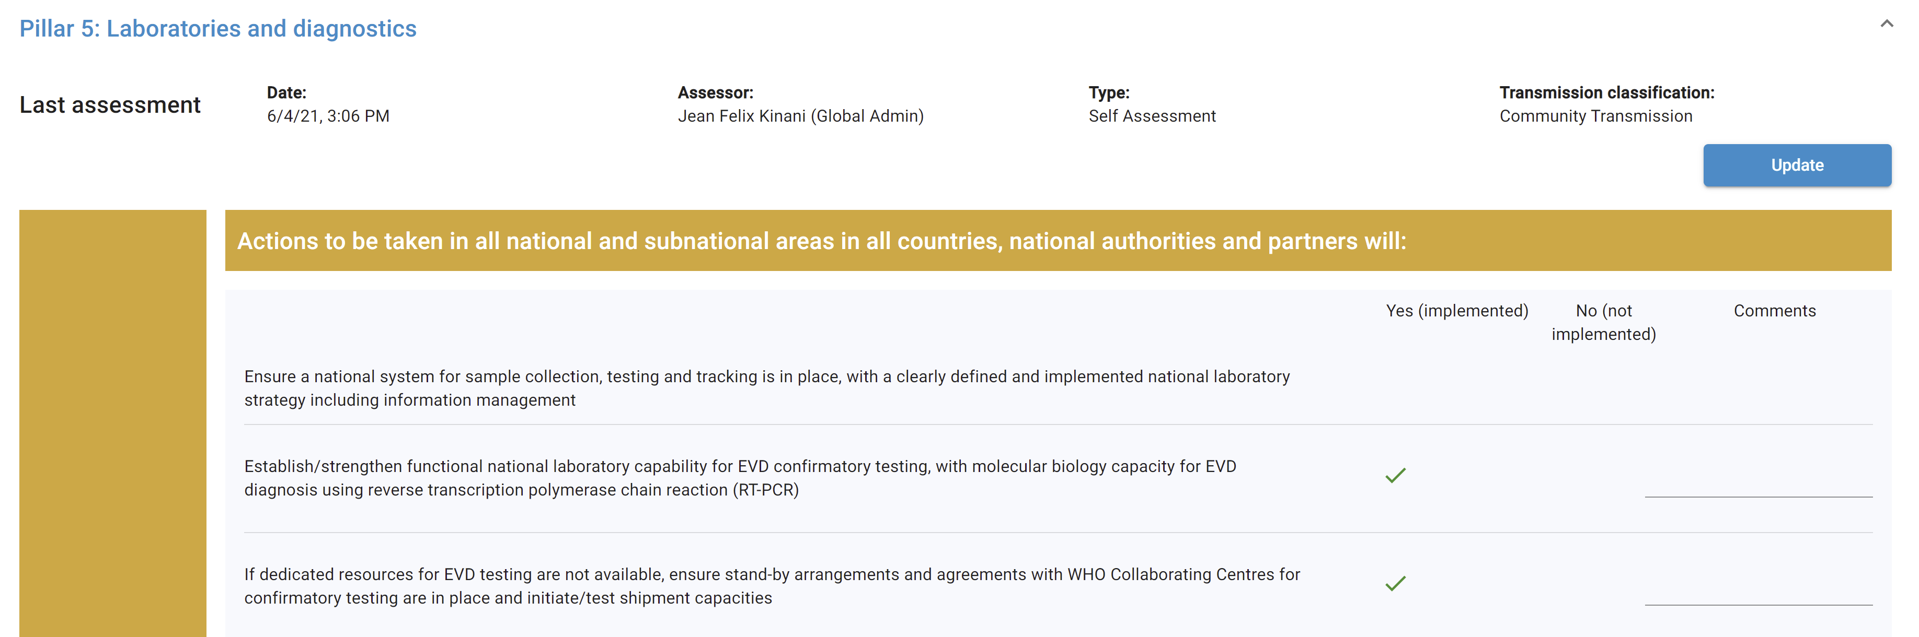
1. Expand and fill out each pillar in the checklist
The country has pre-positioned stock of RDTs and Cary-Blair transport media in 80% of the hotspots
2. Track each action using different options (eg: Yes/No; Planned, Implemented, Maintaining, Not Implemented)
The country has the capacity for both culture techniques and drug susceptibility testing
SOPs for collection, packaging, and transport of samples available in the country

Slide 17
4. Resource Needs and Tracking

Slide 18
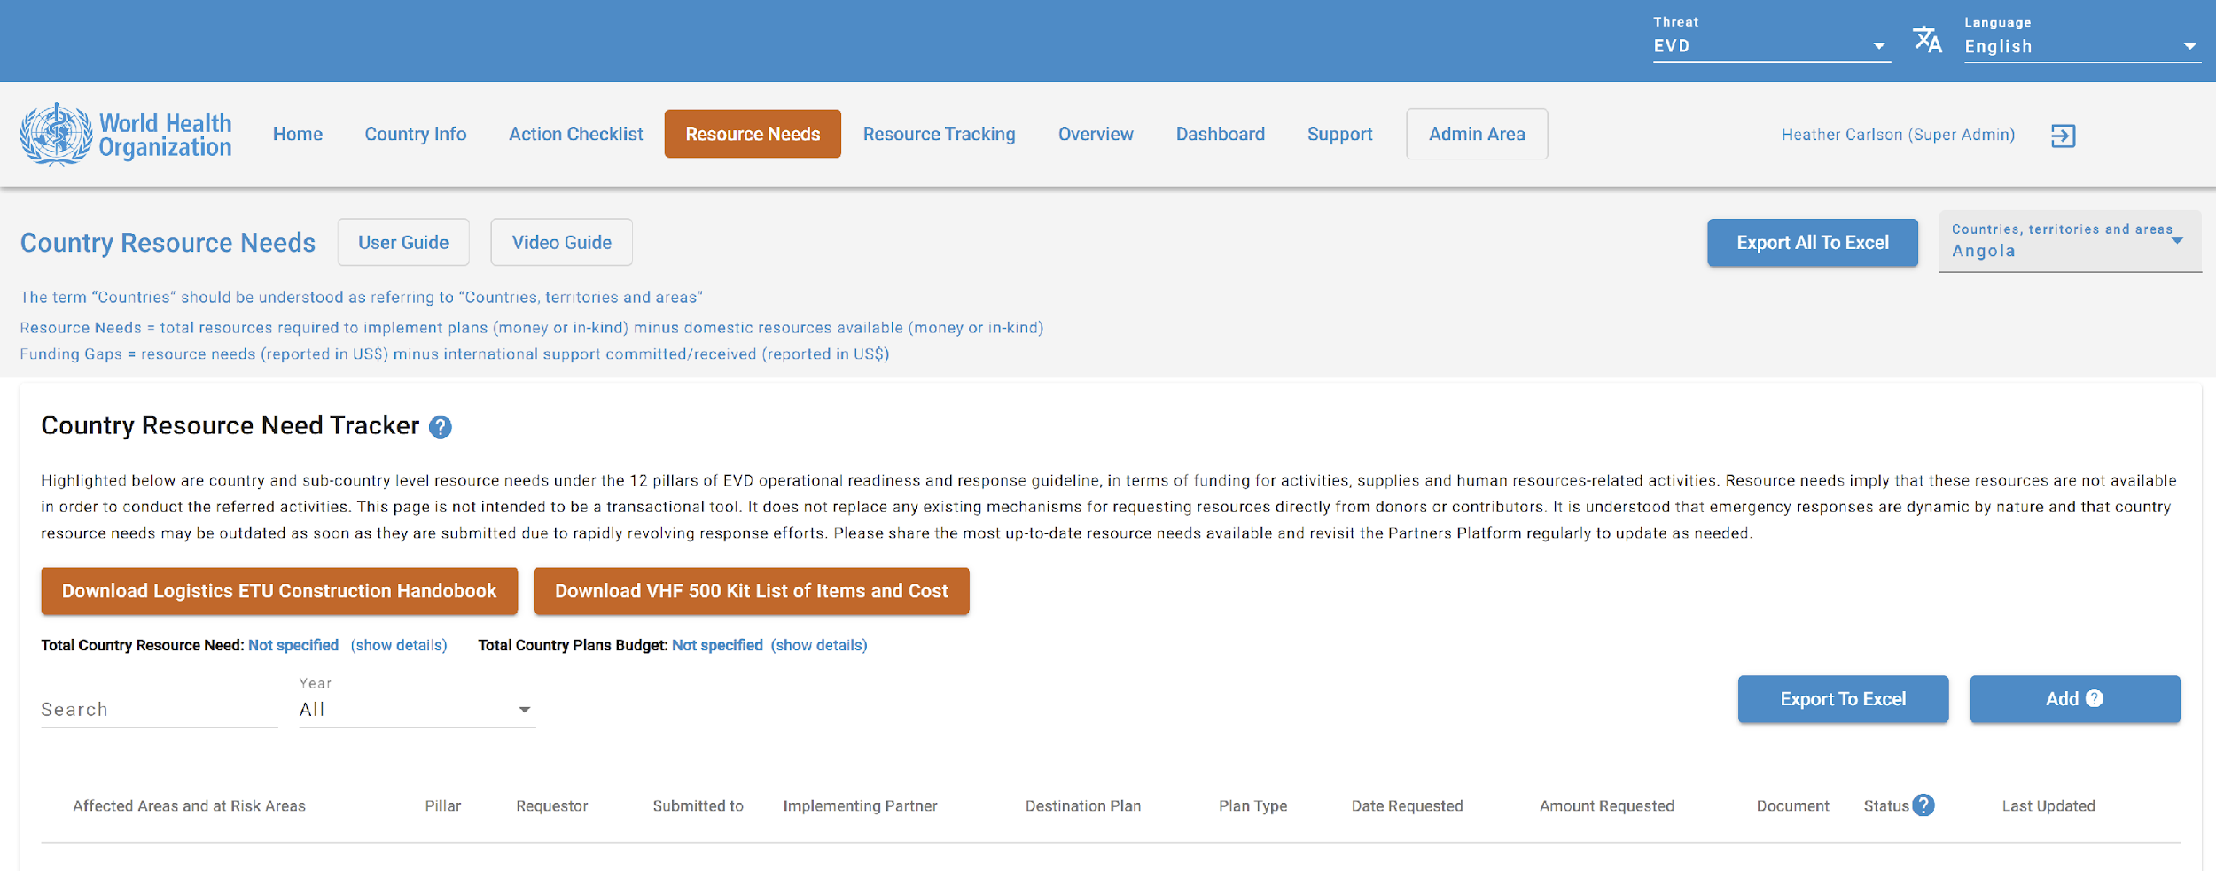





Cholera
1. Choose the affected country here
Download GTFCC IPC and Wash Handbook
Download Cholera Kit Content
2. Download critical documents

Slide 19
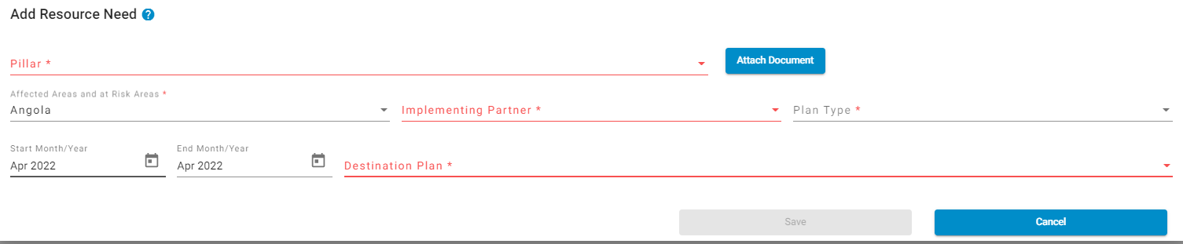
Cholera
2. Select the pillar in the Cholera action checklist where the resources are needed
2. Choose a plan type:
National Plan
Subnational Plan
Multiagency Plan
WHO Country Office Plan
Other Plan
Download Logistics Handbook
Download Kit List and Cost
1. Choose the affected area (national level)
3. Select an implementing partner (gov, ngo, etc)
3. Choose a destination plan:
Cholera Strategic and Response Plan
Cholera Elimination Plan
Cholera Operational Readiness Checklist
Cholera Reviews (SimEx, intra-action After Action, other)
Notes:
To discuss: do they want subnational level?

Slide 20
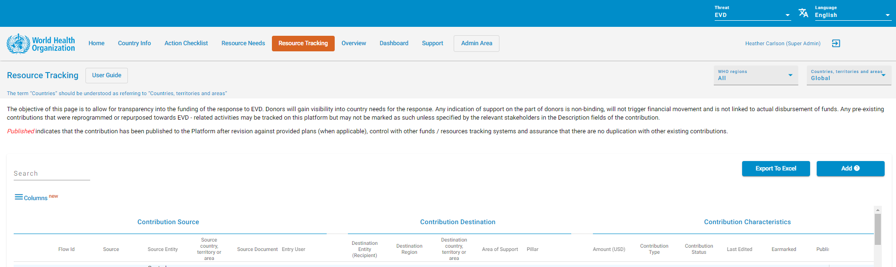
Cholera
Resources Received can be tracked using the same procedure

Slide 21
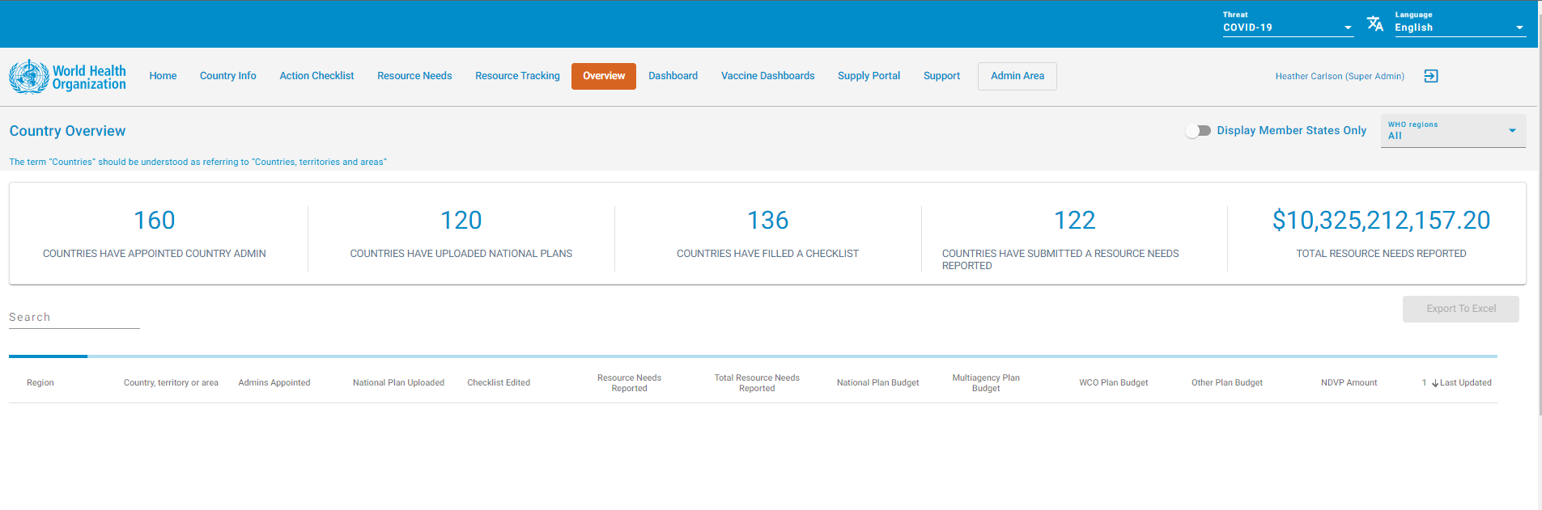


Cholera
View key metrics for the region in the Overview tab

Slide 22
3. Support & Training

Slide 23

Country info
Action Checklist
Resource Track.
Dashboard
Support
Support
Contact us List of References Frequently Asked Questions User Guides Video Tutorials Privacy Policy Terms of Use Learning and Training
Store all important training materials in the support tab
Training Category
Add
GTFCC Cholera Outbreak Response – Field Manual (Octobre 2019)
File Name
File Name
File Name
Simple File Description Simple File Description Simple File Description Simple File Description
Simple File Description Simple File Description Simple File Description Simple File Description
Simple File Description Simple File Description Simple File Description Simple File Description
Training Title
Training Title
Training Title
Training Title

Slide 24
Added Value of the Partners Platform

Slide 25
Improve priority countries’ operational readiness capacities
Accelerate implementation of activities to prevent, detect and respond to identified imminent public health risks at national and subnational levels
Digitize all plans and action checklists to make it easier to work with their data
Improve awareness and knowledge of key multisectoral stakeholders including decision makers on health emergencies operational readiness.
Share needs and plans with major donors who utilize the Platform
Have a means to track funding gaps
Improve multisectoral collaboration among countries, donors and partners for operational readiness to establish health security at national, regional and global levels.
Improve regional, sub-regional, and cross-border readiness

